Slide 1

Operating Systems 2-7029110
Lecture 4 – IPC
Ariel University Computer Science Department
Notes:
http://pubs.opengroup.org/onlinepubs/009695399/functions/xsh_chap02_04.html
<number>

Slide 2
Signals
The signaling system. main purpose: controll another process
What is the handler idea ?
Tutorial: https://www.thegeekstuff.com/2012/03/linux-signals-fundamentals/ example: https://www.thegeekstuff.com/2012/03/catch-signals-sample-c-code/ mask: https://unix.stackexchange.com/questions/85364/how-can-i-check-what-signals-a-process-is-listening-to
Notes:
Open, close, duplicate
Handling signals
When are signals processed
Signals handlers
<number>

Slide 3
Signals
Example commands: kill – l
-sigInt – interupts a process -sigStop – stop (pause) a process -sigCont – continues (resume) a process -sigUsr1 – a “free” signal for developer to use -sigTerm – terminates the prosess gracefully (like ctrl+z) -sigKill – terminates imidiatlly more about mask: https://unix.stackexchange.com/questions/85364/how-can-i-check-what-signals-a-process-is-listening-to
Notes:
Open, close, duplicate
Handling signals
When are signals processed
Signals handlers
<number>

Slide 4
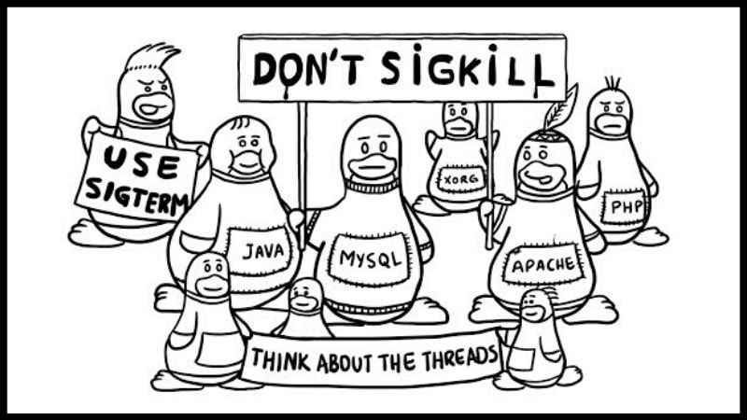
SigTerm vs SigKill
https://linuxhandbook.com/content/images/2020/06/dont_sigkill_use_sigterm.jpg
Notes:
Open, close, duplicate
Handling signals
When are signals processed
Signals handlers
<number>

Slide 5
Data Passing
Notes:
Open, close, duplicate
Handling signals
When are signals processed
Signals handlers
<number>

Slide 6
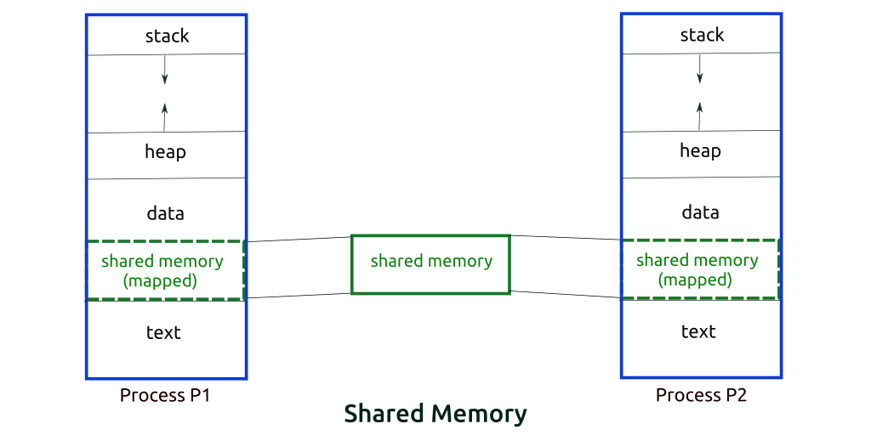
IPC shared memory
https://www.softprayog.in/programming/interprocess-communication-using-system-v-shared-memory-in-linux
Notes:
Open, close, duplicate
Handling signals
When are signals processed
Signals handlers
<number>

Slide 7
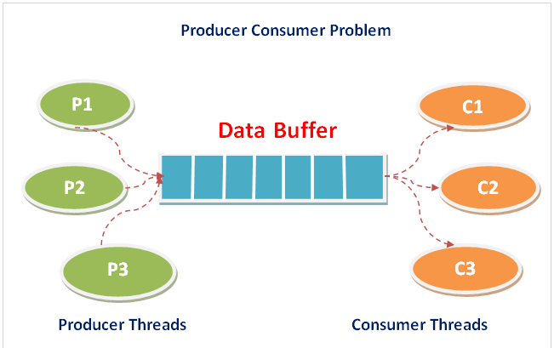
Consumer Producer Problem
https://www.ktustudents.in/2017/10/program-for-producer-consumer-problem-in-c-cs331-lab.html
Notes:
Open, close, duplicate
Handling signals
When are signals processed
Signals handlers
<number>

Slide 8
IPC pipes
Unnamed pipe
Cat history | grep gcc – an example
Named pipe
1) mkfifo some_name 2) echo “some data” > some_name 3) tail -f some_name 4) unlink some_name
https://opensource.com/article/19/4/interprocess-communication-linux-storage https://opensource.com/article/19/4/interprocess-communication-linux-channels
Notes:
Open, close, duplicate
Handling signals
When are signals processed
Signals handlers
<number>

Slide 9
IPC message passing
Send / Receive | Blocking
MailBox | Non blocking one to many
Pipe | Short life (depends on process)
Pipe named | Access by name, “fils” file. Multiple acces
File (disk and ram) | Utilize File System
Socket | Utilize Networking (PORT)
Notes:
Open, close, duplicate
Handling signals
When are signals processed
Signals handlers
<number>

Slide 10
IPC message passing
Shared Memory | Message passing
FAST | SAFE
Non controlled | controlled
async | Sync and Async
Notes:
Open, close, duplicate
Handling signals
When are signals processed
Signals handlers
<number>

